Slide 1
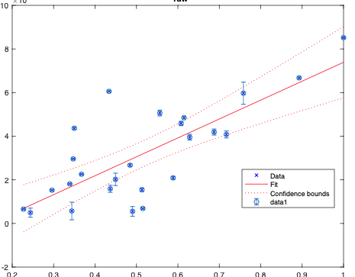
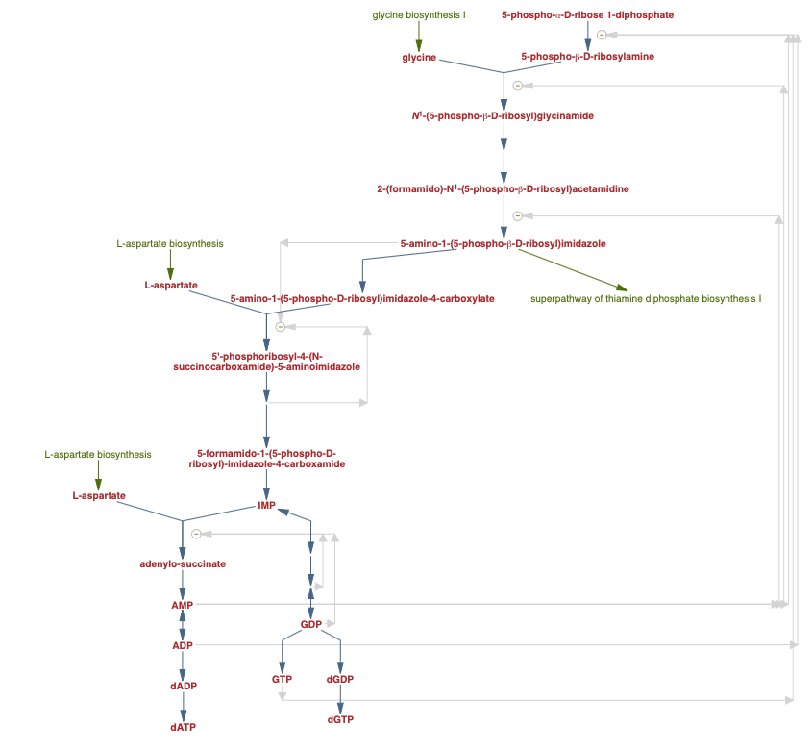
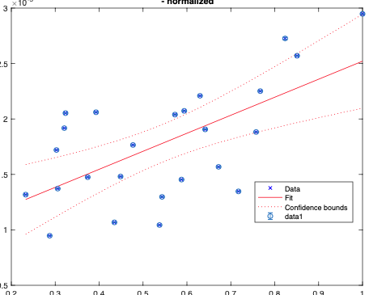
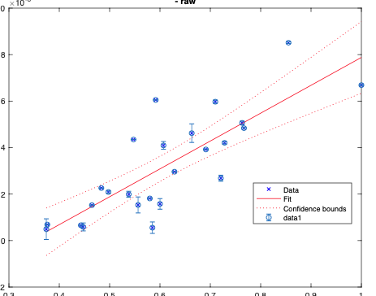
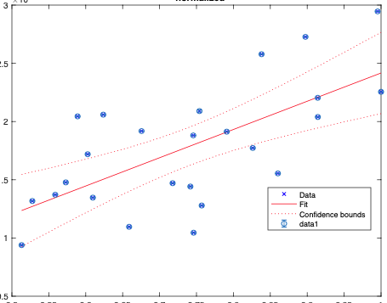
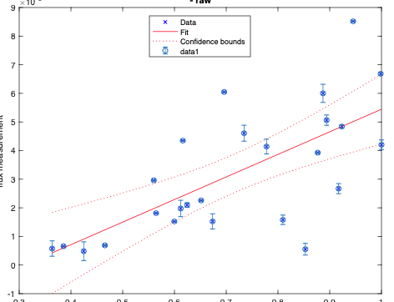
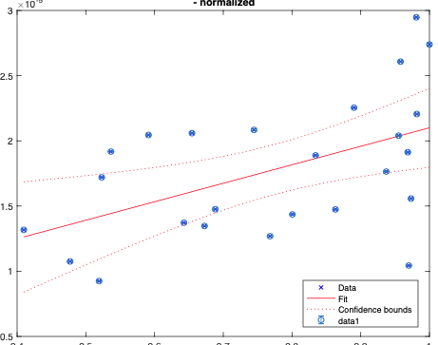
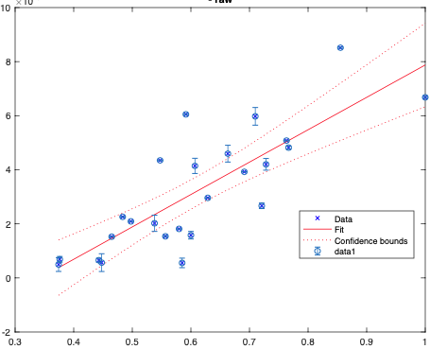
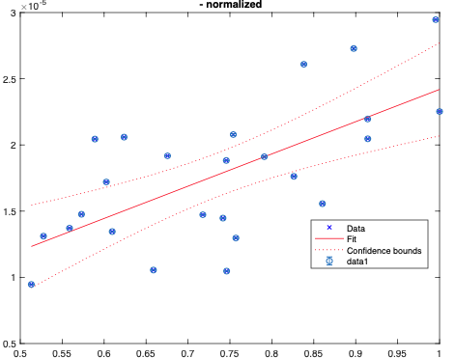
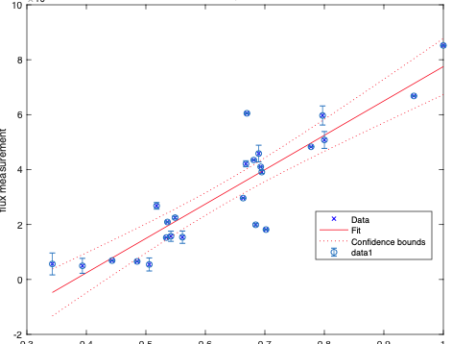
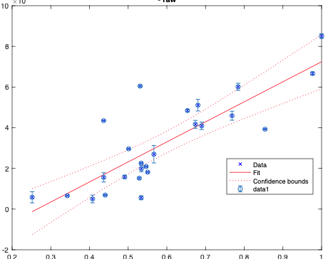
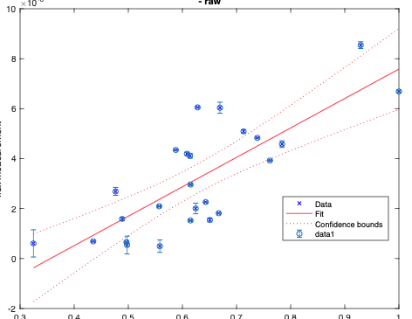
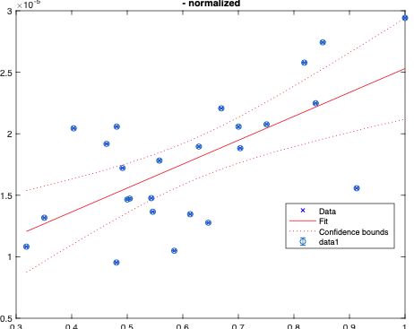
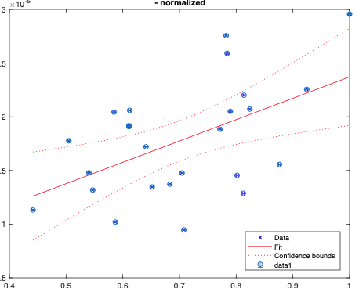
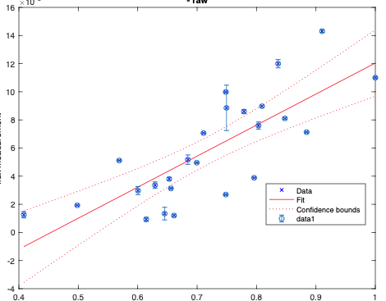
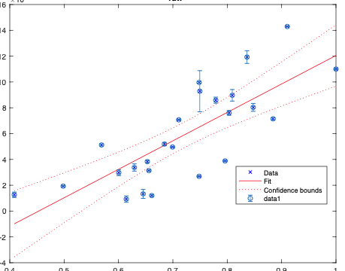
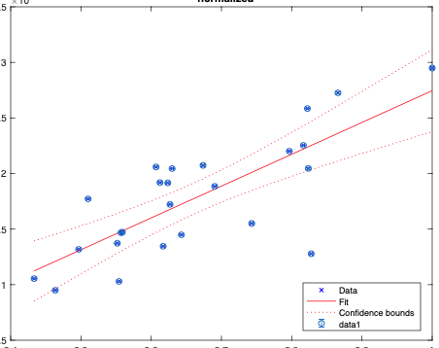
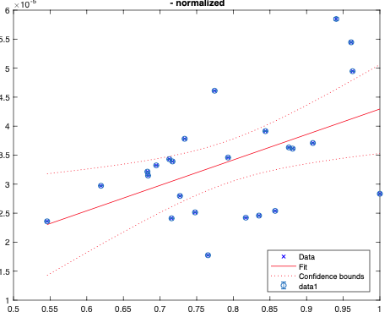
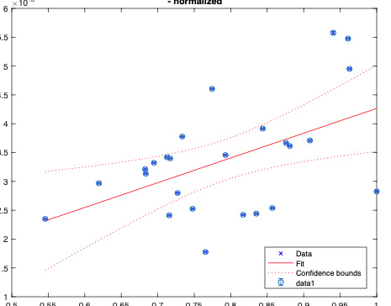
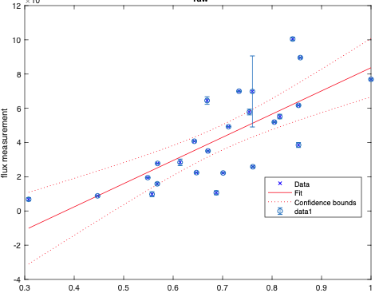
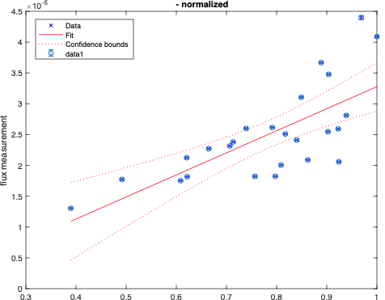
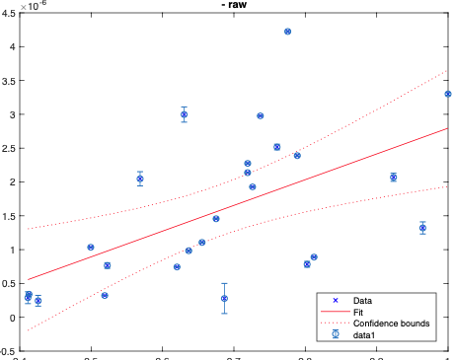
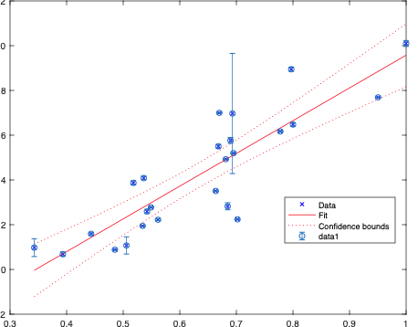
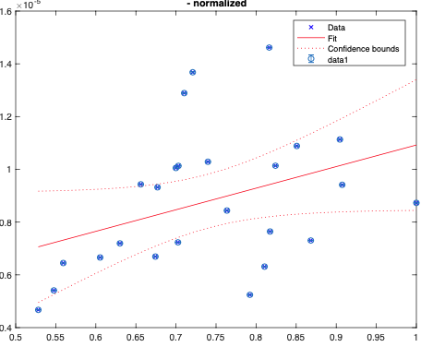
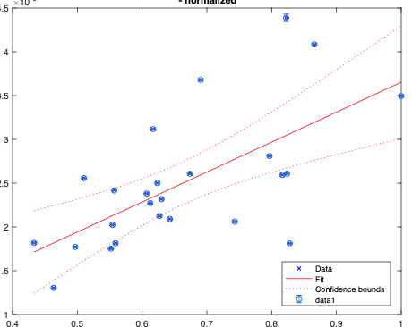
Purine metabolism
raw - raw
relative - relative
Additionally predicted in FPA

Slide 2
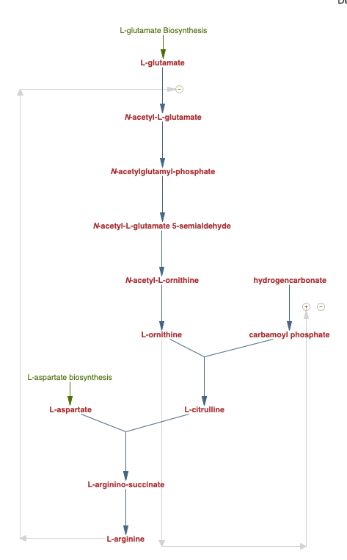
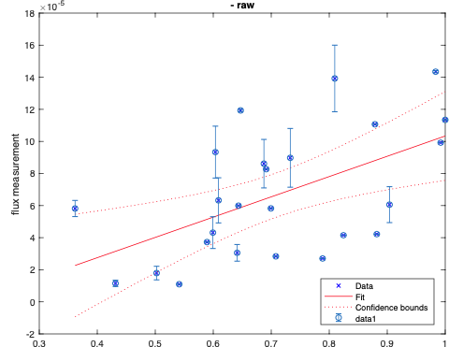
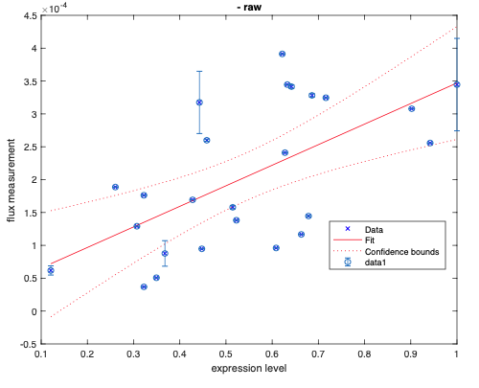
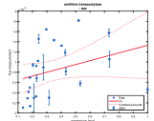
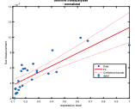
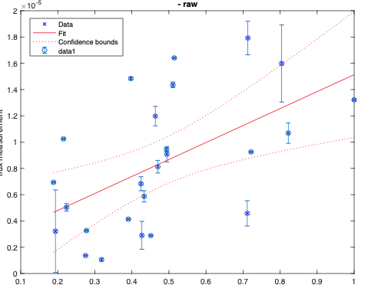
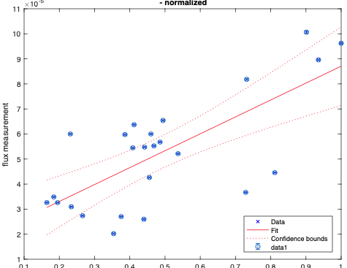
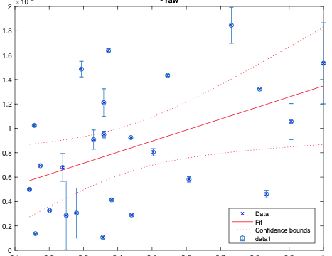
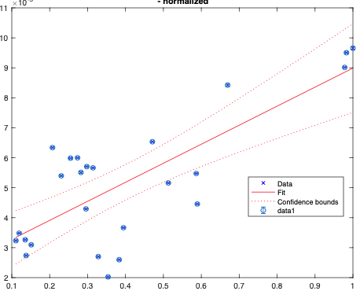
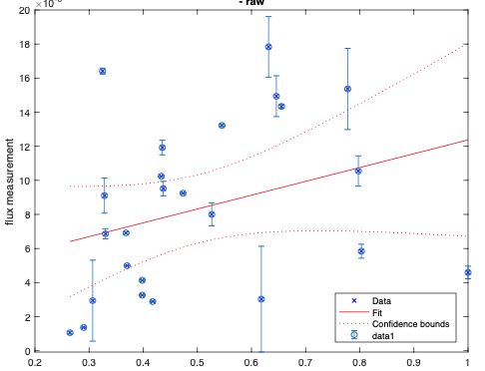
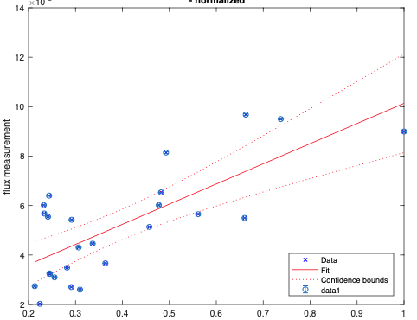
akg
akg
: significant correlation
: (new) significant correlation in relative-relative comparison
: significant in raw-raw but not significant in relative-relative
L-gamma-glutamyl phosphate
Additionally predicted in FPA
Arginine biosynthesis
L-glutamic 5-semialdehyde
raw - raw
1-pyrroline-5-carboxylate
L-proline
Notes:
try raw to relative

Slide 3
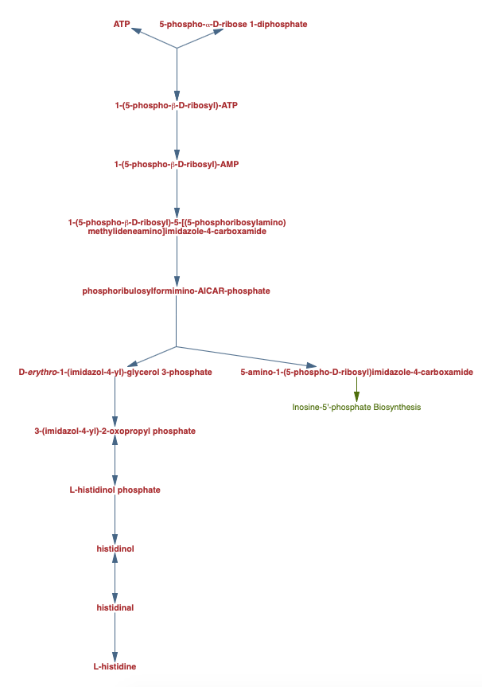
Histidine metabolism
raw - raw
relative - relative
Additionally predicted in FPA

Slide 4
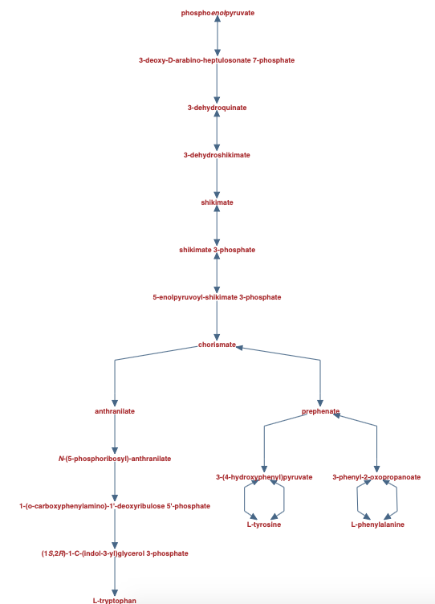
shikimate pathway
(Phenylalanine, tyrosine and tryptophan biosynthesis)
raw - raw
relative - relative
Additionally predicted in FPA

Slide 5
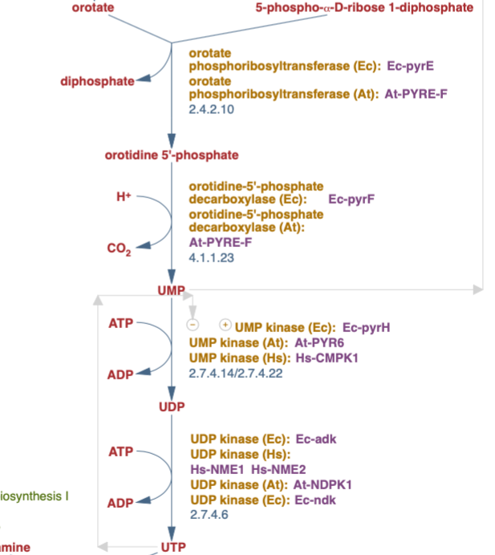
Pyrimidine metabolism
raw - raw
relative - relative
PRPP + uracil
PRPP + uracil
(S)-dihydroorotate
N-carbamoyl-L-aspartate
Missed in FPA
carbamoyl phosphate
Additionally predicted in FPA

Slide 6
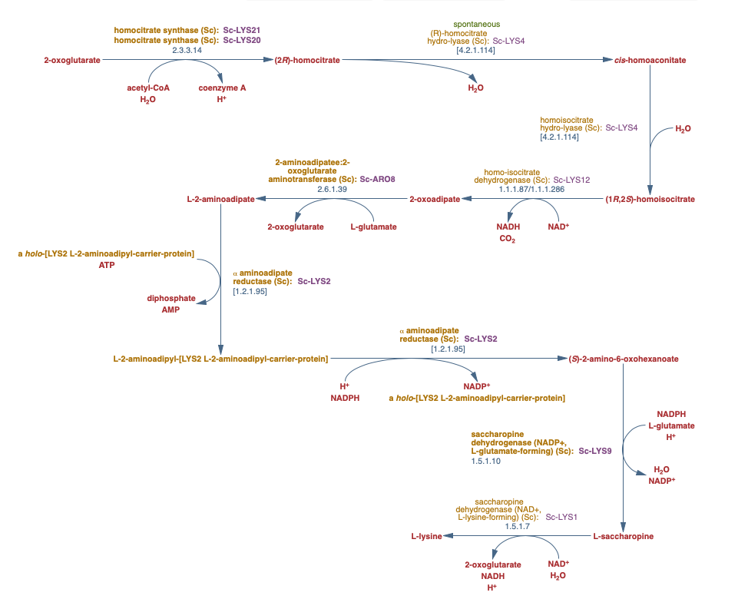
Lysine biosynthesis
raw - raw
relative - relative
Additionally predicted in FPA

Slide 7
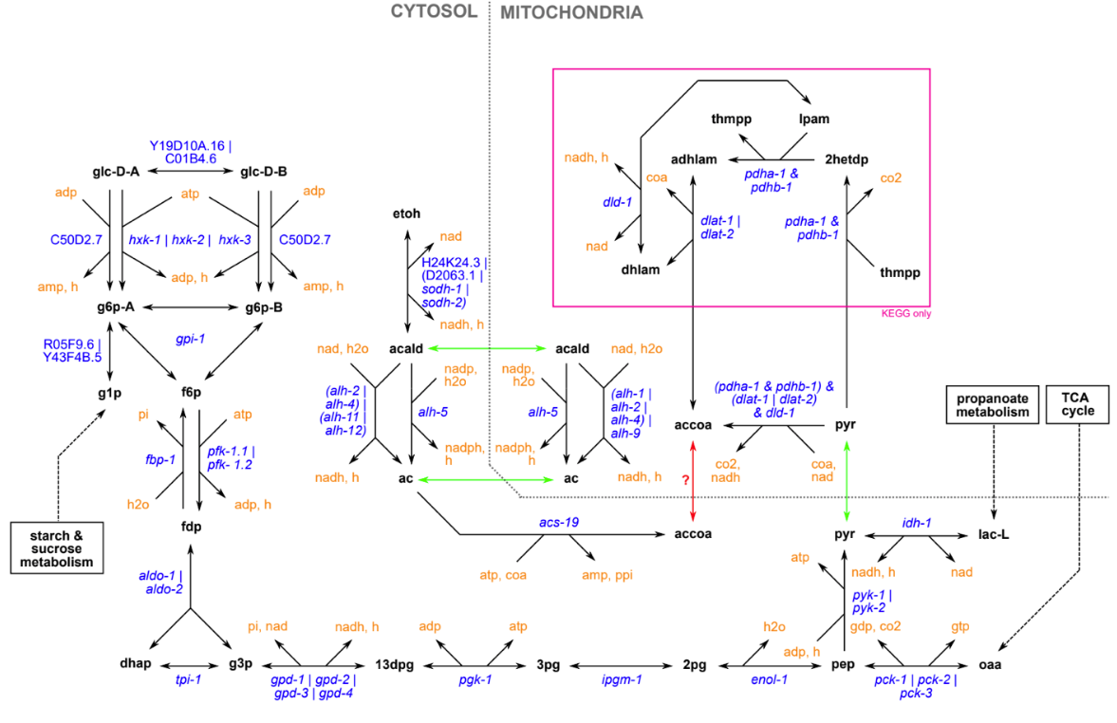
Gluconeogenesis
raw - raw
relative - relative
acald
: significant correlation
: (new) significant correlation in relative-relative comparison
Additionally predicted in FPA
: significant in raw-raw but not significant in relative-relative

Slide 8
TRX1-disulfite
TRX1
adenosine 3',5'-bismonophosphate
AMP

Slide 9
Sulfate metabolism
raw - raw
relative - relative
Additionally predicted in FPA

Slide 10
raw-raw
L-glutamate
L-gamma-glutamyl phosphate
L-glutamic 5-semialdehyde
Arginine and proline metabolism
relative-relative
L-glutamate
L-gamma-glutamyl phosphate
L-glutamic 5-semialdehyde
raw-raw
dihydroxyacetone phosphate
glycerol 3-phosphate
glycerol
Glycerophospholipid metabolism
relative-relative
dihydroxyacetone phosphate
glycerol 3-phosphate
glycerol
raw-raw
g6p
alpha,alpha-trehalose 6-phosphate
trehalose
Starch and sucrose metabolism
relative-relative
g6p
alpha,alpha-trehalose 6-phosphate
trehalose
Additionally predicted in FPA

Slide 11
rxnID | Formula | Subsystem | rho
'r_0364' | 'dUTP [cytoplasm] + H2O [cytoplasm] -> diphosphate [cytoplasm] + dUMP [cytoplasm] + H+ [cytoplasm] ' | Pyrimidine metabolism' | 0.80692307692307
'r_0889' | '''6-phospho-D-gluconate [cytoplasm] + NADP(+) [cytoplasm] -> carbon dioxide [cytoplasm] + D-ribulose 5-phosphate [cytoplasm] + NA...'' <Preview truncated at 128 characters>' | Pentose phosphate pathway | 0.591538462
'r_0211' | '''ATP [cytoplasm] + H2O [cytoplasm] + L-aspartate [cytoplasm] + L-glutamine [cytoplasm] -> AMP [cytoplasm] + diphosphate [cytopla...'' <Preview truncated at 128 characters>' | Alanine, aspartate and glutamate metabolism' | 0.684615385
'r_0547' | 'H+ [cytoplasm] + L-aspartate 4-semialdehyde [cytoplasm] + NADPH [cytoplasm] -> L-homoserine [cytoplasm] + NADP(+) [cytoplasm] ' | Glycine, serine and threonine metabolism' | 0.845384615
'r_0005' | 'UDP-D-glucose [cytoplasm] -> (1->3)-beta-D-glucan [cell envelope] + H+ [cytoplasm] + UDP [cytoplasm] ' | Starch and sucrose metabolism' | 0.806923077
'r_0362' | '''dolichyl D-mannosyl phosphate [endoplasmic reticulum] -> dolichyl phosphate [endoplasmic reticulum] + H+ [endoplasmic reticulum...'' <Preview truncated at 128 characters>' | Other types of O-glycan biosynthesis' | 0.876153846
'r_0080' | '''5,10-methylenetetrahydrofolate [cytoplasm] + 2 H+ [cytoplasm] + NADPH [cytoplasm] -> 5-methyltetrahydrofolate [cytoplasm] + NAD...'' <Preview truncated at 128 characters>' | One carbon pool by folate' | 0.433076923
'r_0489' | glycerol 3-phosphate [cytoplasm] + H2O [cytoplasm] -> glycerol [cytoplasm] + phosphate [cytoplasm] ' | Glycerolipid metabolism' | 0.553846154
'r_0718' | '''(S)-malate [mitochondrion] + NAD [mitochondrion] -> carbon dioxide [mitochondrion] + NADH [mitochondrion] + pyruvate [mitochond...'' <Preview truncated at 128 characters>' | Pyruvate metabolism' | 0.646153846
'r_1088' | '''2-oxoglutarate [mitochondrion] + L-valine [mitochondrion] <=> 3-methyl-2-oxobutanoate [mitochondrion] + L-glutamate [mitochondr...'' <Preview truncated at 128 characters>' | Cysteine and methionine metabolism' | 0.697692308
'r_1022' | '''ADP [mitochondrion] + phosphate [mitochondrion] + succinyl-CoA [mitochondrion] -> ATP [mitochondrion] + coenzyme A [mitochondri...'' <Preview truncated at 128 characters>' | Citrate cycle (TCA cycle)' | 0.57
'r_0219' | '''4-phospho-L-aspartate [cytoplasm] + H+ [cytoplasm] + NADPH [cytoplasm] -> L-aspartate 4-semialdehyde [cytoplasm] + NADP(+) [cyt...'' <Preview truncated at 128 characters>' | Glycine, serine and threonine metabolism' | 0.53230769
'r_0353' | '(2R,3R)-2,3-dihydroxy-3-methylpentanoate [mitochondrion] -> (S)-3-methyl-2-oxopentanoate [mitochondrion] + H2O [mitochondrion] ' | Valine, leucine and isoleucine biosynthesis' | 0.57076923
In raw-raw: 54/65 (83%) are closely connected pathways!!
In relative-relative: 39/46 (85%) are closely connected pathways
Only in raw-raw
In both
Only in relative-relative

Slide 12
New transporter flux
EX | 'cstm_s_1269_TCE' | 'orotate [cytoplasm] <=> s_1269[e] ' | ''
EX | 'r_1115' | 'ammonium [extracellular] <=> ammonium [cytoplasm] ' | ''
EX | 'r_1211' | 'H+ [extracellular] + L-leucine [extracellular] <=> H+ [cytoplasm] + L-leucine [cytoplasm] ' | ''
MT | 'r_1237' | 'H+ [cytoplasm] + ornithine [mitochondrion] -> H+ [mitochondrion] + ornithine [cytoplasm] ' | ''
EX | 'r_1272' | 'H+ [extracellular] + uracil [extracellular] -> H+ [cytoplasm] + uracil [cytoplasm] ' | ''
MT | 'r_2034' | 'H+ [cytoplasm] + pyruvate [cytoplasm] -> H+ [mitochondrion] + pyruvate [mitochondrion] ' | ''
MT | 'r_2093' | 'L-valine [cytoplasm] <=> L-valine [mitochondrion] ' | ''
EX | 'r_1166' | D-glucose [extracellular] -> D-glucose [cytoplasm] '

Slide 13
UNCLEAR rxns and isolated rxns
Only sig in rel-rel FPA
 | 'r_1936' | 'dihydroxyacetone phosphate [cytoplasm] -> methylglyoxal [cytoplasm] + phosphate [cytoplasm] ' | ''
Originally only significant in raw-raw; now also significant in rel-rel FPA
'r_0080' | '''5,10-methylenetetrahydrofolate [cytoplasm] + 2 H+ [cytoplasm] + NADPH [cytoplasm] -> 5-methyltetrahydrofolate [cytoplasm] + NAD...'' <Preview truncated at 128 characters>' | One carbon pool by folate' | 0.433076923

Slide 14
Missed in FPA
Is isolated rxn in pathway analysis of correlation result
Yes | 'r_1022' | '''ADP [mitochondrion] + phosphate [mitochondrion] + succinyl-CoA [mitochondrion] -> ATP [mitochondrion] + coenzyme A [mitochondri...'' <Preview truncated at 128 characters>' | 'sce00020 Citrate cycle (TCA cycle)'
yes | 'r_0219' | '''4-phospho-L-aspartate [cytoplasm] + H+ [cytoplasm] + NADPH [cytoplasm] -> L-aspartate 4-semialdehyde [cytoplasm] + NADP(+) [cyt...'' <Preview truncated at 128 characters>' | Glycine, serine and threonine metabolism'
yes | 'r_0353' | '(2R,3R)-2,3-dihydroxy-3-methylpentanoate [mitochondrion] -> (S)-3-methyl-2-oxopentanoate [mitochondrion] + H2O [mitochondrion] ' | Valine, leucine and isoleucine biosynthesis'

Slide 15
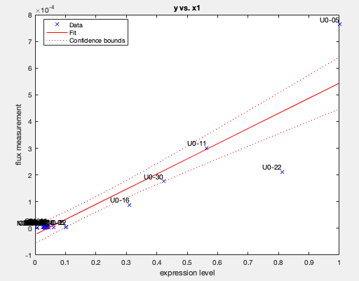
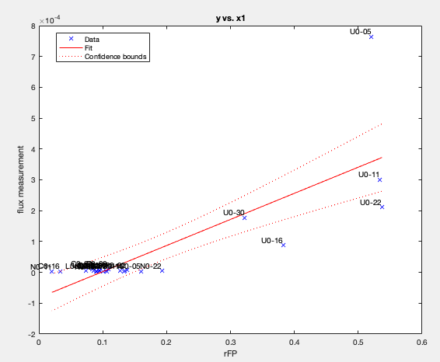
Case-by-case analysis of the predicted transporters
EX | 'cstm_s_1269_TCE' | 'orotate [cytoplasm] <=> s_1269[e] ' | ''
'cstm_s_1269_TCE'
r_0453
'2 ATP [cytoplasm] + bicarbonate [cytoplasm] + H2O [cytoplasm] + L-glutamine [cytoplasm] -> 2 ADP [cytoplasm] + carbamoyl phosphate [cytoplasm] + 2 H+ [cytoplasm] + L-glutamate [cytoplasm] + phosphate [cytoplasm] '
'carbamoyl phosphate [cytoplasm] + L-aspartate [cytoplasm] -> H+ [cytoplasm] + N-carbamoyl-L-aspartate [cytoplasm] + phosphate [cytoplasm] '
'H+ [cytoplasm] + N-carbamoyl-L-aspartate [cytoplasm] -> (S)-dihydroorotate [cytoplasm] + H2O [cytoplasm] '
r_0453
'(S)-dihydroorotate [cytoplasm] + fumarate [cytoplasm] -> orotate [cytoplasm] + succinate [cytoplasm] '

Slide 16
dist = 1.25; has protein data
dist = 1.25; no protein data

Slide 17
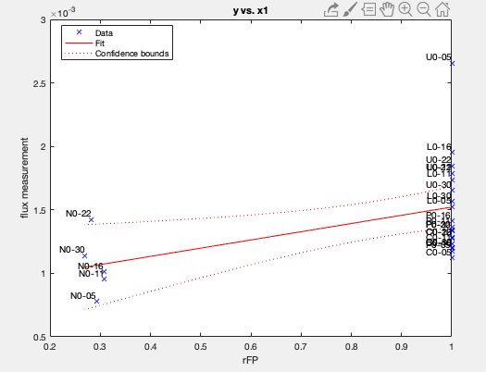
EX | 'r_1115' | 'ammonium [extracellular] <=> ammonium [cytoplasm] ' | ''
In non-nitrogen limiting media: because nh4 cause big distance to any reaction and nh4 is freely available, it is freely uptaken and thus has 1 FP (full)
In nitrogen limiting media, because nitrogen uptake is penalized (10 vs 0), the producing of nh4 provides higher potential, so the FP of nh4 uptake is reflecting the expression of expression of asparagine synthesis
'r_0211' 'ATP [cytoplasm] + H2O [cytoplasm] + L-aspartate [cytoplasm] + L-glutamine [cytoplasm] -> AMP [cytoplasm] + diphosphate [cytoplasm] + H+ [cytoplasm] + L-asparagine [cytoplasm] + L-glutamate [cytoplasm] '
'r_1186_b' 'H+ [cytoplasm] + L-asparagine [cytoplasm] -> H+ [extracellular] + L-asparagine [extracellular] '
Clearly the mechanism is a coincidence. The fundamental reason of the prediction is the manual penalty setting of nh4+ exchange. It is a good prediction from modeling but it is trival.

Slide 18
EX | 'r_1211' | 'H+ [extracellular] + L-leucine [extracellular] <=> H+ [cytoplasm] + L-leucine [cytoplasm] '
EX | 'r_1272' | 'H+ [extracellular] + uracil [extracellular] -> H+ [cytoplasm] + uracil [cytoplasm] '
Same as nitrogen, due to manual penalty

Slide 19
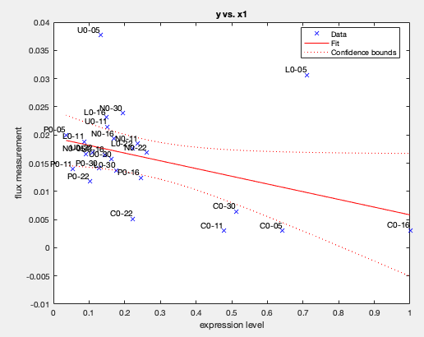
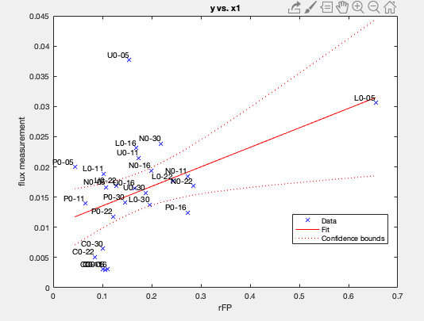
EX | 'r_1166' | D-glucose [extracellular] -> D-glucose [cytoplasm] '
The glucose transporter expression predicts the L0-05; the manual penalty corrects the FP for all C-limiting conditions; the expression of r_4235 may minorly contributes to the rest of predictive power;
Note that, for glucose transporter FP, the dOrder =0 predicts best, which integrates more gene expression in glycolysis pathway and may also be an interesting example
(in weighted distance + exponential decay FPA, only glucose transporter itself and r_4235 contributes to FPA)

Slide 20
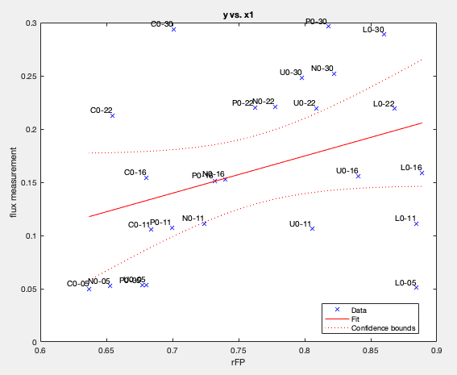
FPA, weighted dist, exp decay, predict growth
Quite global prediction
Many tRNA synth
Amino acid syn

Slide 21
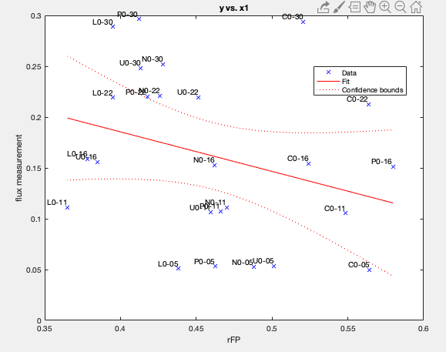
When doing global integration, it is not predictive (n2 = 100)
MAYBE because the global is a biased prediction, the Flux allowance is dominated by large flux such as OXPHOS and glucose transport

Slide 22
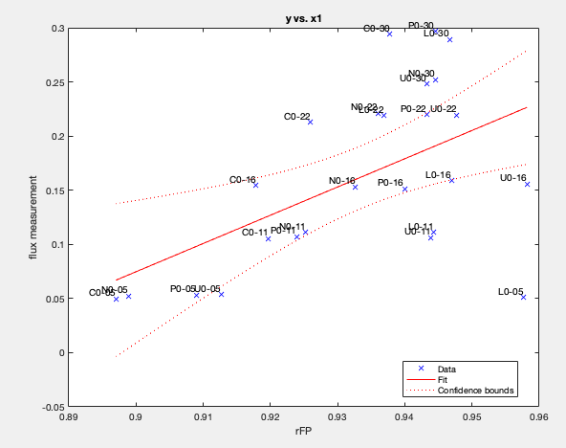
An acceptable good correlation is also seen for normal FPA with weighted dist;
But the dOrder needs to be 4 (relatively local)
And the rFP value is not greatly changed in scale (min = 0.89 max = 0.96)
It can’t be predicted meaningfully by normal distance. Because if by normal distance, the dOrder MUST BE very local (>=8) to capture the signal. But then the rFP value is very large (0.9982~0.9991) and it is not a meaningful variation

